Slide 1
PecConfig
March 17th, 2015
Cathy Ding
International Business Department

Slide 2

Content
Communication Settings
Energy Measurement Settings
Content
Power Quality Settings
Question & Answer

Slide 3



PecConfig
Power Quality
Settings
Energy
Measurement
Definition
Communication
Setup
Logic Layer:
PQ Group
PQ Node
Link Device
V Nominal
Harmonic Limit
Logic Layer:
Energy Group
Energy Node
Link Device
Energy Source
Demand Source
Physical Layer:
Station
Site
Device
Data Point
Datalog Source
for PQ Analyzers
for Energy Meters

Slide 4

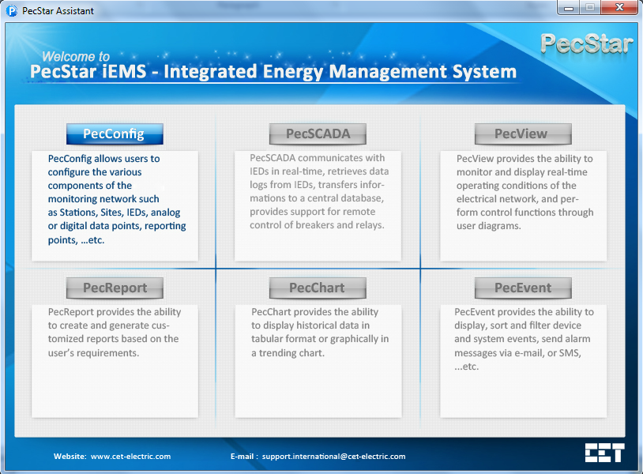
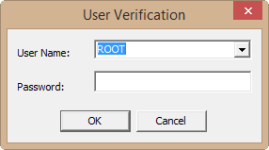
PecConfig Communication Settings
Starting PecConfig.
Double-click the PecAssistant icon on the desktop and click PecConfig.
Use Name: ROOT
Password:
Then click OK.
Click Start > All Programs > iEMS V3.6 > System Configuration Module > PecConfig.
Navigate to the D:\CET\Common folder, and double-click PecConfig.exe.

Slide 5
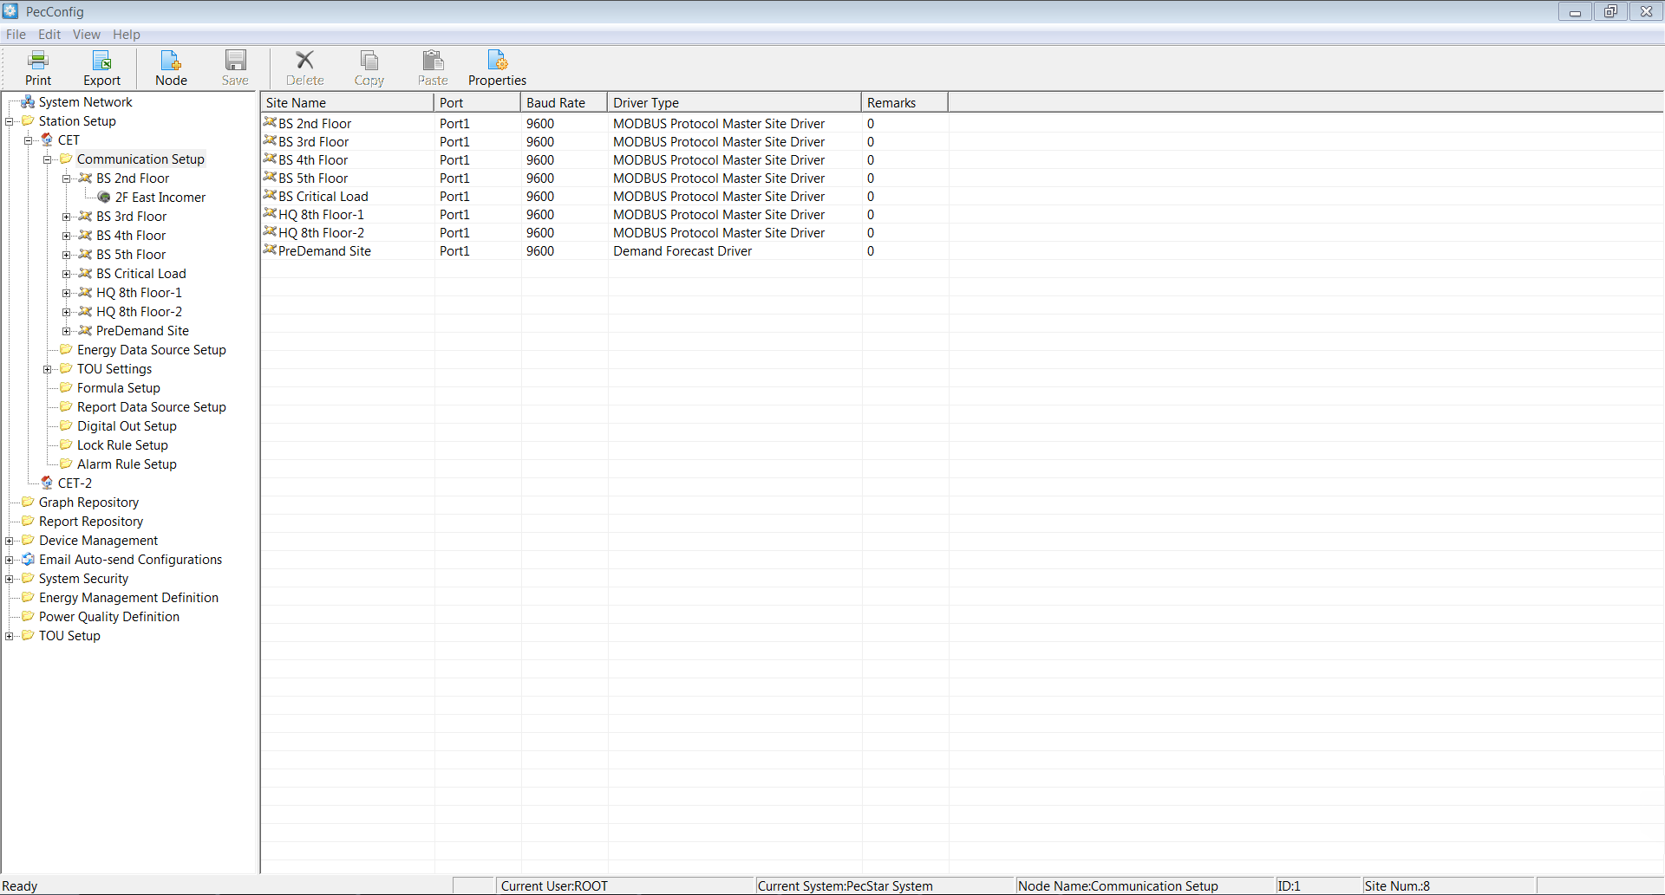
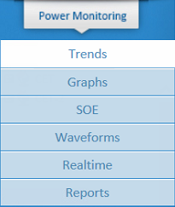
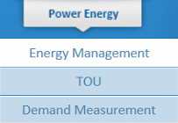
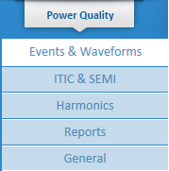
PecConfig Communication Settings
Menu
Toolbar
1
Display area
2
3
Setup Pane
Status bar

Slide 6
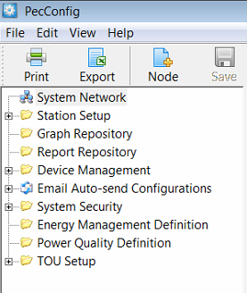
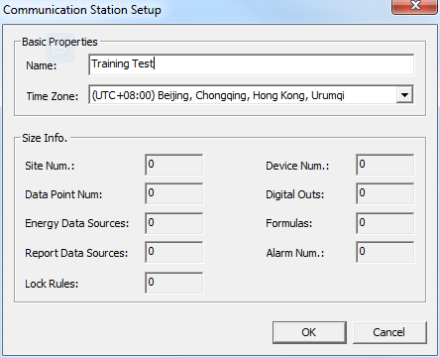
PecConfig Communication Settings
Add a Station. Click Station Setup, then click Node, the Communication Station Setup window appears. Input the Name and choose the corresponding Time Zone. Then click OK.
2
3
4
1
5

Slide 7
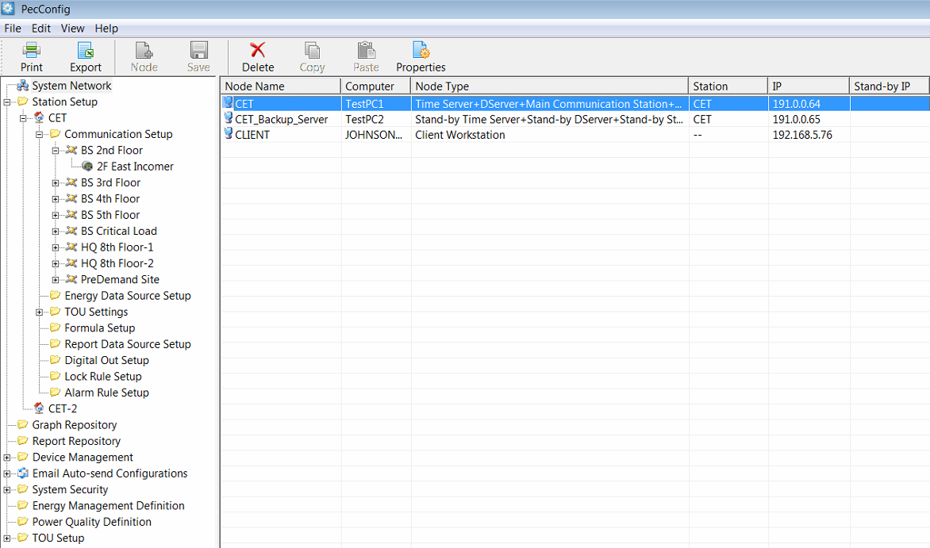
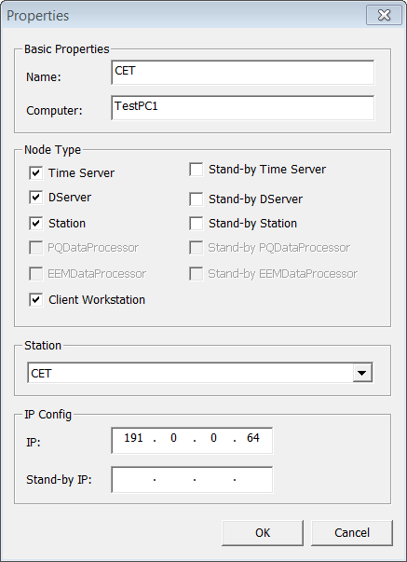
PecConfig Communication Settings
Setup System Network. Click System Network, then double-click the node, the Properties window appears. Input the Name, Computer, IP. Choose the Node Type and Station.
1
2
3
The node referring to the local
machine is created automatically
after adding a station.
4
5
6
7
8

Slide 8
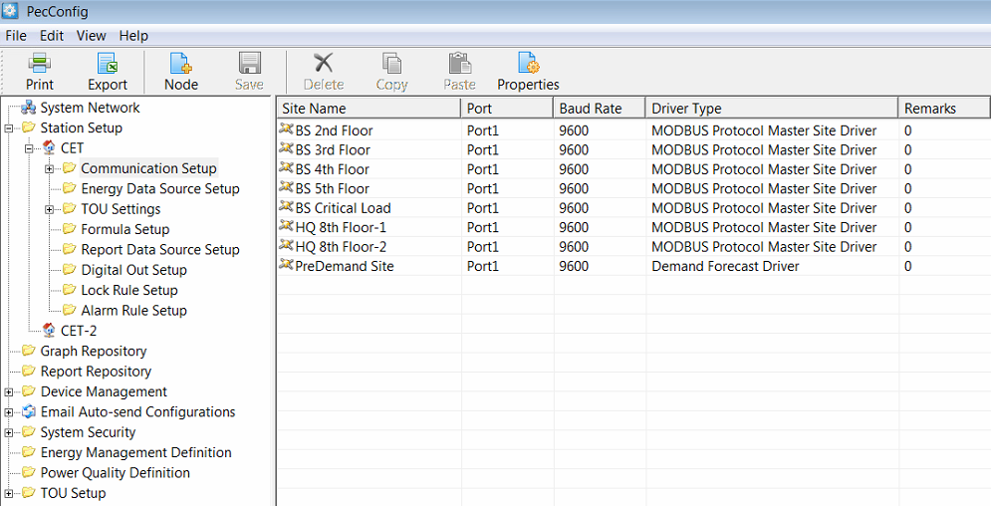
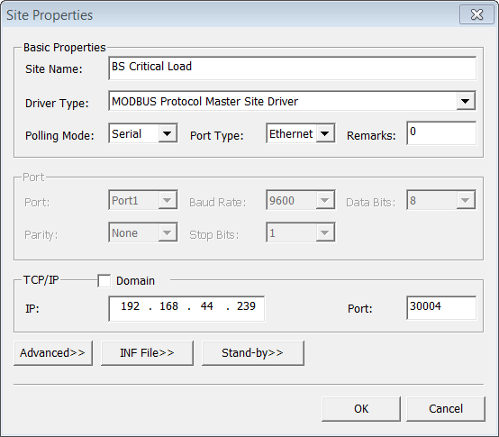
PecConfig Communication Settings
Add a Site. Click Communication Setup, then click Node, the Site Properties window appears. Input the Site Name, chose the corresponding Driver Type, select the communication parameters according to the network and device settings.
Example: Modbus Protocol, EtherGate
2
3
4
1
5
6
7
8
9

Slide 9
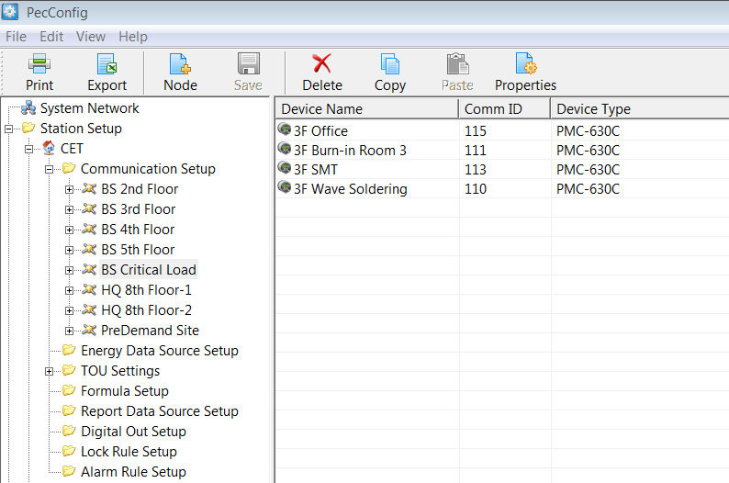
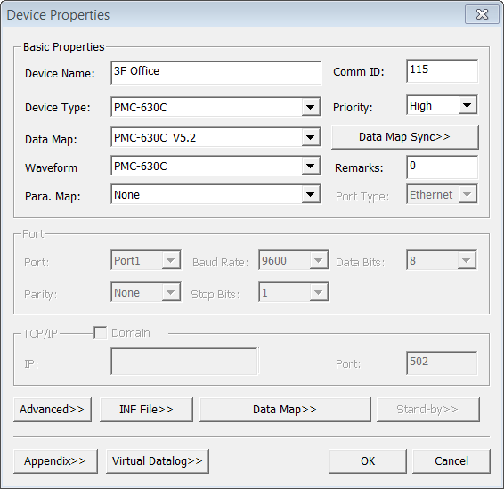
PecConfig Communication Settings
Add a Device. Click the site, then click Node, the Device Properties window appears. Input the Device Name, Comm ID, choose the Device Type, Data Map and Waveform Map if available. Then click OK.
2
3
4
5
6
7
1
8

Slide 10
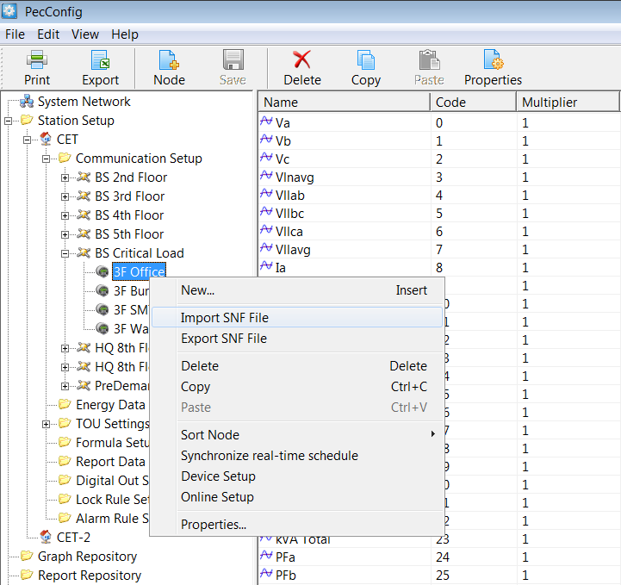
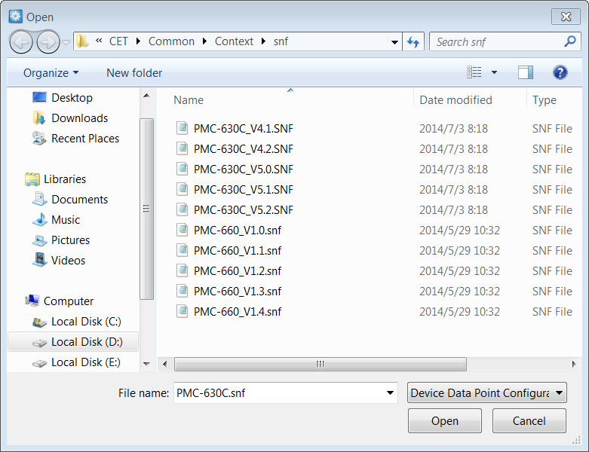
PecConfig Communication Settings
Import SNF File. If the system does not import the .snf file automatically, we should do it manually. Select the device and right-click on it, choose Import SNF File from the pop-up menu, and choose the corresponding .snf file. The default .snf files are put under the \CET\Common\Context folder after the device drivers are installed.
1
3
2
4

Slide 11
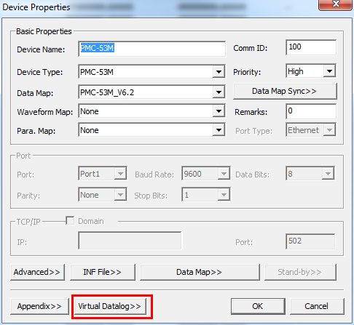
PecConfig Communication Settings
Enable Virtual Datalog if the meter does not have data recorders.
Select the device and open Device Properties window, click Virtual Datalog>>.
For example, PMC-53M does not support on-board datalogs.
We can setup Virtual Datalog in PecConfig for software datalogs.
1

Slide 12
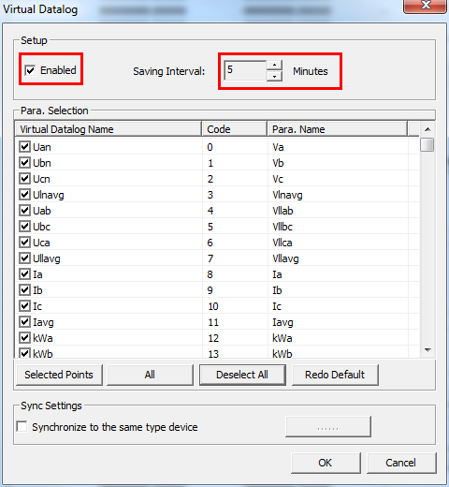
PecConfig Communication Settings
Check Enabled and set the Saving Interval. Then choose the parameters you want to do software datalogs from the Para. Selection list, and click OK.
1
2
3
The Virtual Datalog settings will
be applied to the same type of
meters if check this option.
4

Slide 13
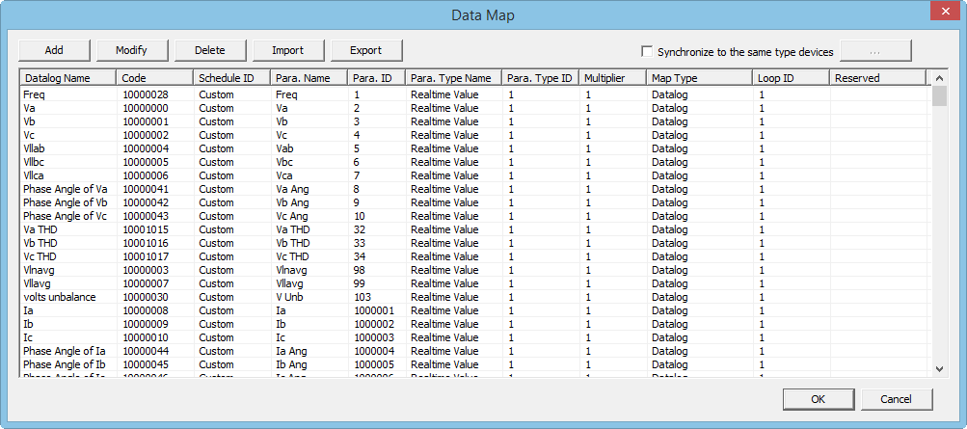
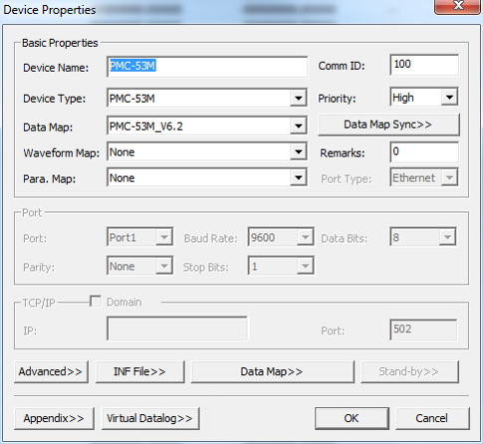
PecConfig Communication Settings
Verify Datalog settings. Click Data Map>> from the Device Properties window. All datalog parameters will be listed in the window.
The Code of Virtual
Datalog starts from
10,000,000.
2
PMC meters have default data maps. You need to setup the meter’s data recorders correctly before communicating with the meter by iEMS.
1

Slide 14
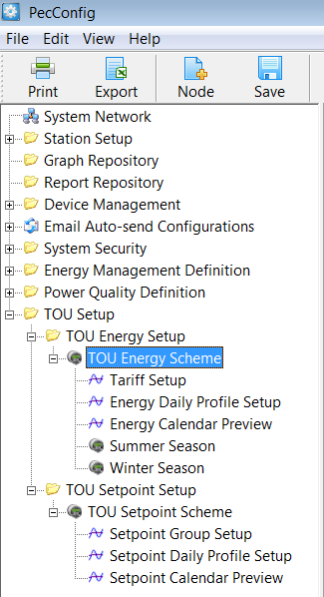
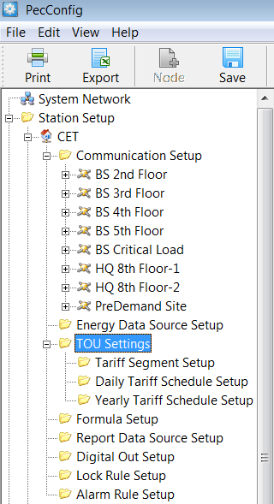
PecConfig Communication Settings
Enable Virtual Datalog if the meter does not have data recorders. Click Energy Management Definition, then click Node, the Energy Group Properties window appears. Input the Name of the energy group. Then click OK.
New
1
Old
TOU Energy Setup: Used for energy billing management.
TOU Setpoint Setup: Used for demand management. When actual value exceeds the limits, the system will give an alarm.
2

Slide 15
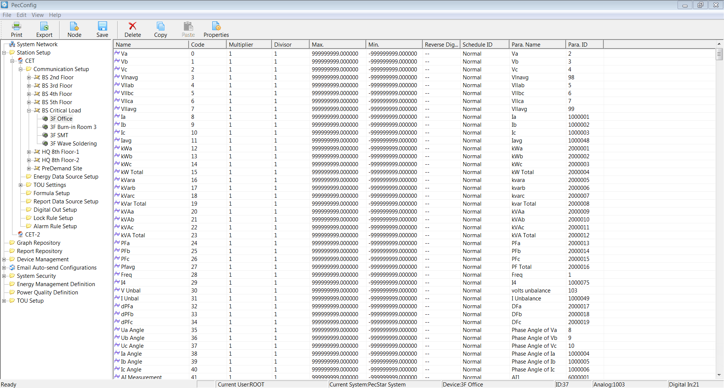
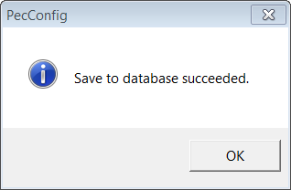
PecConfig Communication Settings
Save all the settings. Click OK when prompt ‘Save to database succeeded.’
1
The Code of is pre-defined
by the device driver.
2

Slide 16


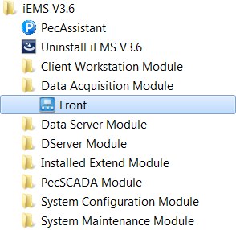
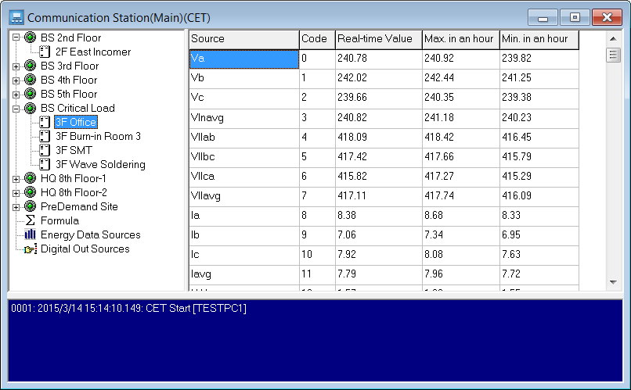
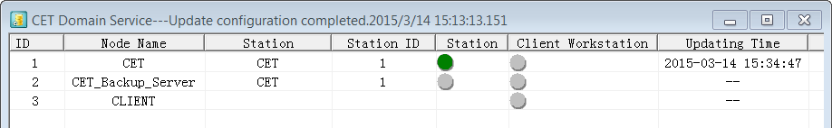
Check Communication Status
After the basic communication configuration is done, open PecSCADA (Front.exe) to check the communication.
Note: Ensure that the DServer is running.

Slide 17
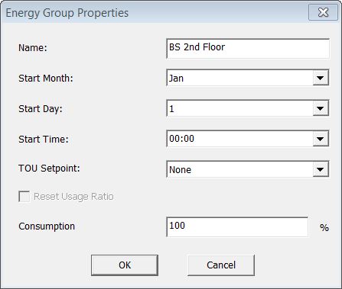
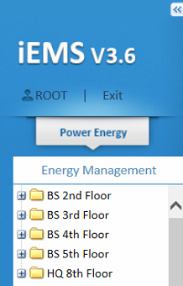
PecConfig Energy Measurement Settings
Add an Energy Group. Click Energy Management Definition, then click Node, the Energy Group Properties window appears. Input the Name of the energy group. Then click OK.
2
3
1
4
Energy Management is used to manage logical node of energy consumption measurement via associating with devices and related parameters. You can statistic energy consumption for areas by creating Energy Group to divide areas.

Slide 18
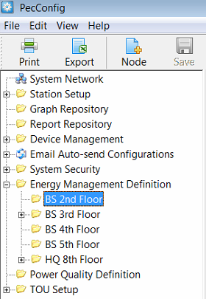
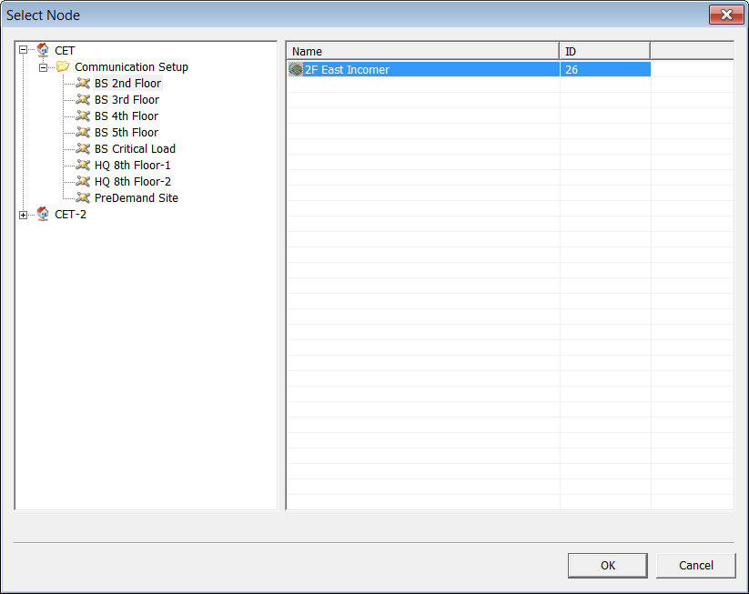
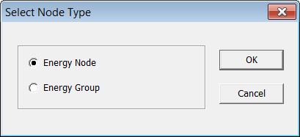
PecConfig Energy Measurement Settings
Add an Energy Node. Click the energy group, then click Node, the Select Node Type window appears. Select Energy Node and click OK. Then select the device from the Select Node window and click OK.
2
4
5
1
3
6

Slide 19
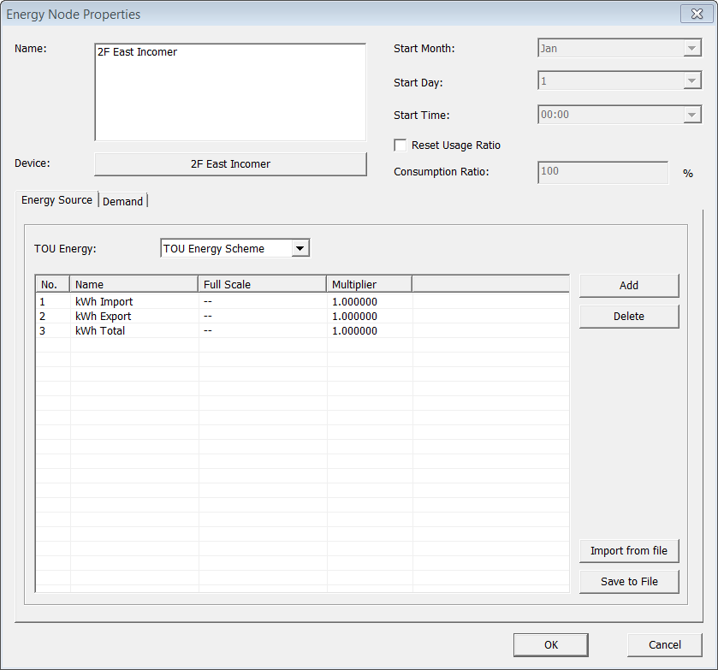
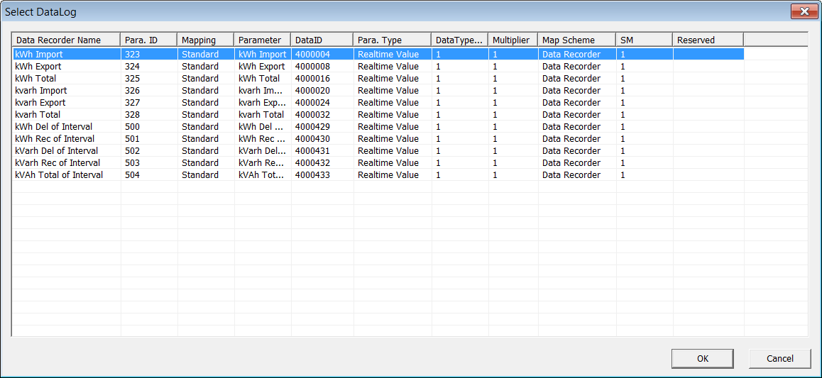
PecConfig Energy Measurement Settings
Set Energy Source. The Energy Node Properties window appears. In the Energy Source tab, click Add, select the energy parameter from the Select Datalog window, then click OK. Select TOU Energy if you want to apply any TOU energy scheme for this device.
1
2
4
3

Slide 20
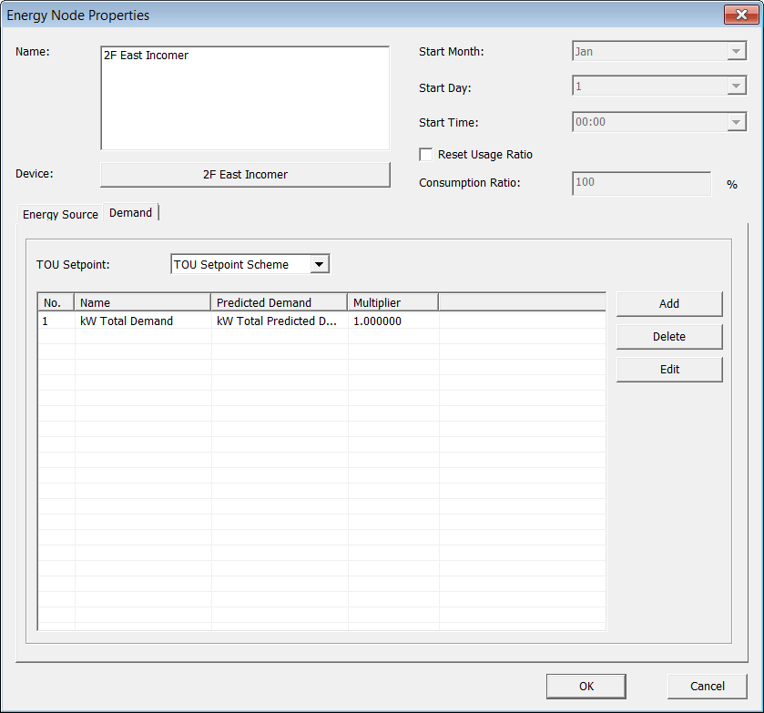
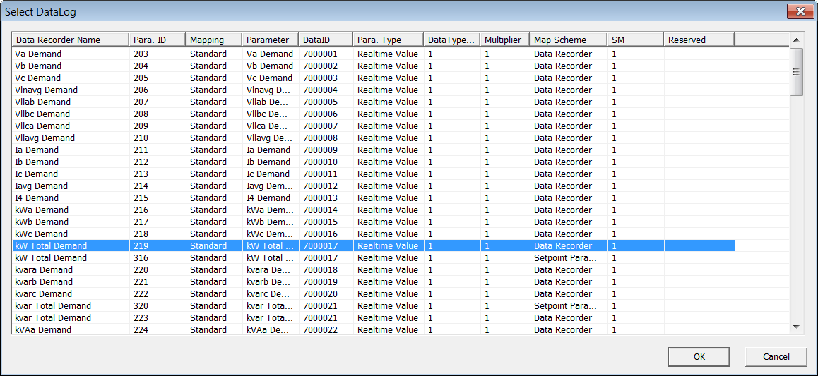
PecConfig Energy Measurement Settings
Set Demand Source. In the Demand tab, click Add, select the demand parameter from the Select Datalog window, then click OK. Select TOU Setpoint if you want to apply any TOU setpoint scheme for this device.
1
2
4
3

Slide 21
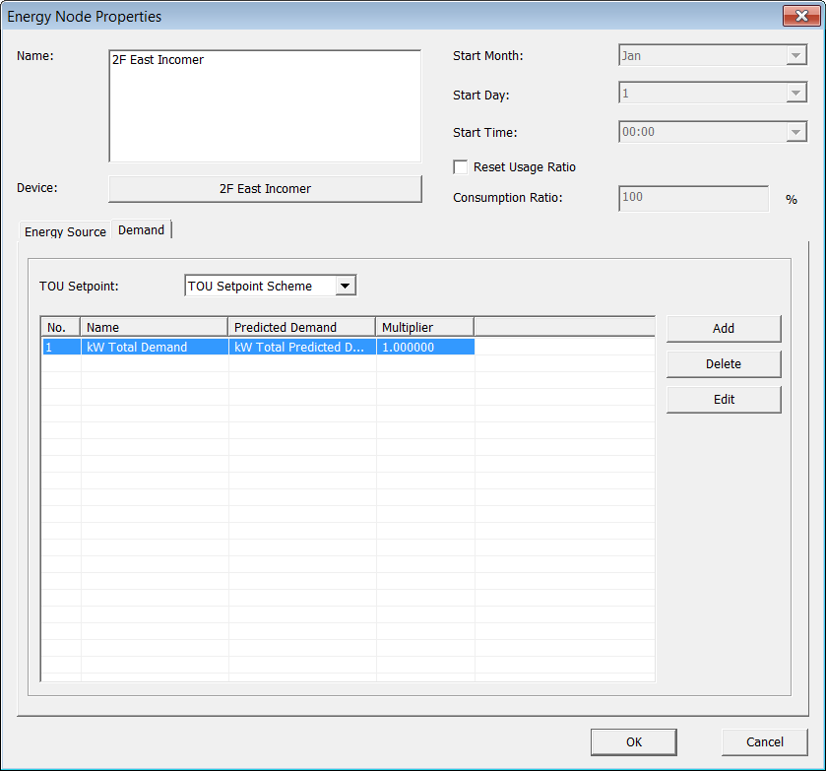
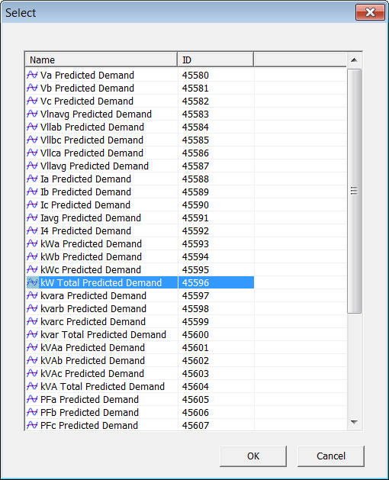
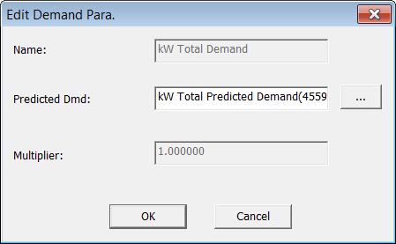
PecConfig Energy Measurement Settings
Set Predicted Demand Source. In the Demand tab, select a demand source and click Edit, the Edit Demand Para. Window appears. Click the … button and select the predicted demand parameter from the Select window, then click OK.
3
1
5
2
6
4

Slide 22
PecConfig Energy Measurement Settings
After this configuration, PecStar iEMS will compare present demand with predicted demand. If (Present demand + Predicted demand) > Demand Contract Value, the system will alarm.
6. Save all the settings. Click OK when prompt ‘Save to database succeeded.’

Slide 23
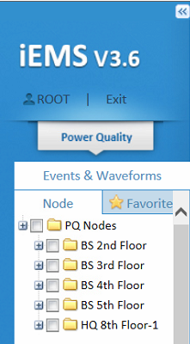
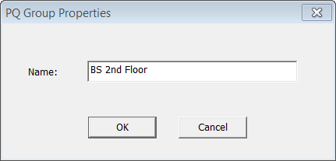
PecConfig Power Quality Settings
Add a Station. Click Station Setup, then click Node, the PQ Group Properties window appears. Input the Name and click OK.
2
3
1
4
Power Quality is used to monitor power quality events such as sag/swell, transient or harmonic setpoint events for logical node by associate with PQ devices. You should configure the Power Quality first and then query the PQ information in iEMS Web.

Slide 24
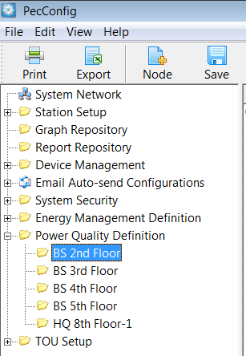

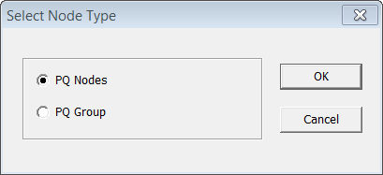
PecConfig Power Quality Settings
Add an Energy Node. Click the energy group, then click Node, the Select Node Type window appears. Select PQ Nodes and click OK. Then select the device from the Select Node window and click OK.
2
2
4
5
1
1
3
6

Slide 25
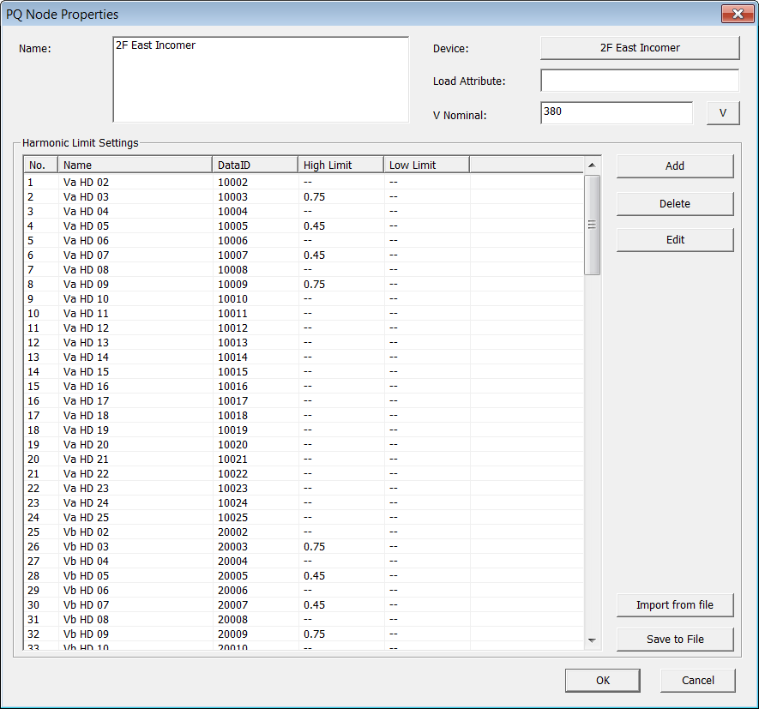
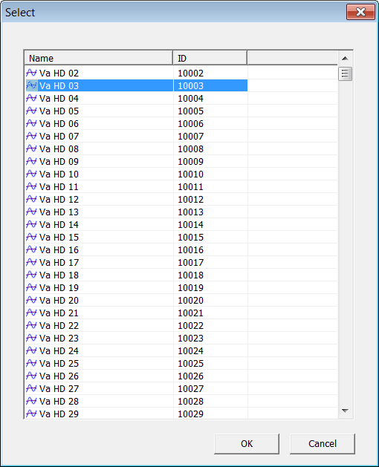
PecConfig Power Quality Settings
Set PQ Node. The PQ Node Properties window appears. Input the V Nominal. You can change the unit of voltage from V to kV by clicking the V toggle button. Click Add, select the harmonic parameter from the Select window, then click OK.
1
2
3
4
4

Slide 26
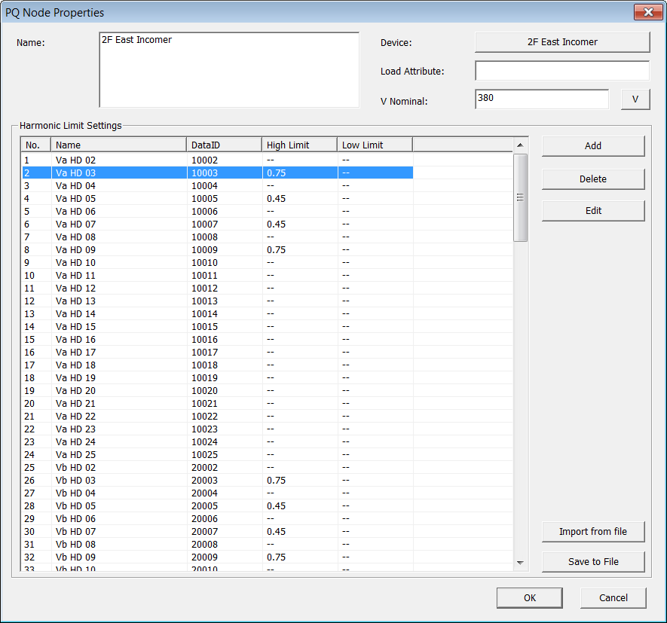
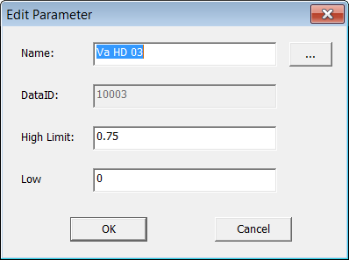
PecConfig Power Quality Settings
Set Harmonic Limit. In the Harmonic Limit Settings list, select a harmonic source and click Edit, the Edit Parameter Window appears. Input the High Limit and Low Limit, then click OK.
1
2
3
4
5
The harmonic limit settings can be
saved to Threshold.INI file and
import from an existing file.
5

Slide 27
PecConfig Power Quality Settings
iEMS V3.6 provides tolerance curve, including ITIC Curve and SEMI Curve, by monitoring disturbed voltage. Provides sag/swell event report and device setpoint report through monitoring voltage event. Also, iEMS V3.6 displays real-time waveform for device and you can compare harmonics.
Save all the settings. Click OK when prompt ‘Save to database succeeded.’

Slide 28
Exercise
Exercise: Connect a PMC-630A meter to your iEMS V3.6 system.
Objectives:
  Able to setup virtual datalog
  Able to read realtime data from the PMC-630A meter in PecSCADA
  Able to show the energy nodes in iEMS V3.6 Web

Slide 29

Questions?

